Slide 1

Smart Librarian
ONN WEI CHENG YANG JIE SHEN
NIRAV JANAK PARIKH
https://ychef.files.bbci.co.uk/976x549/p03gg1lc.jpg

Slide 2
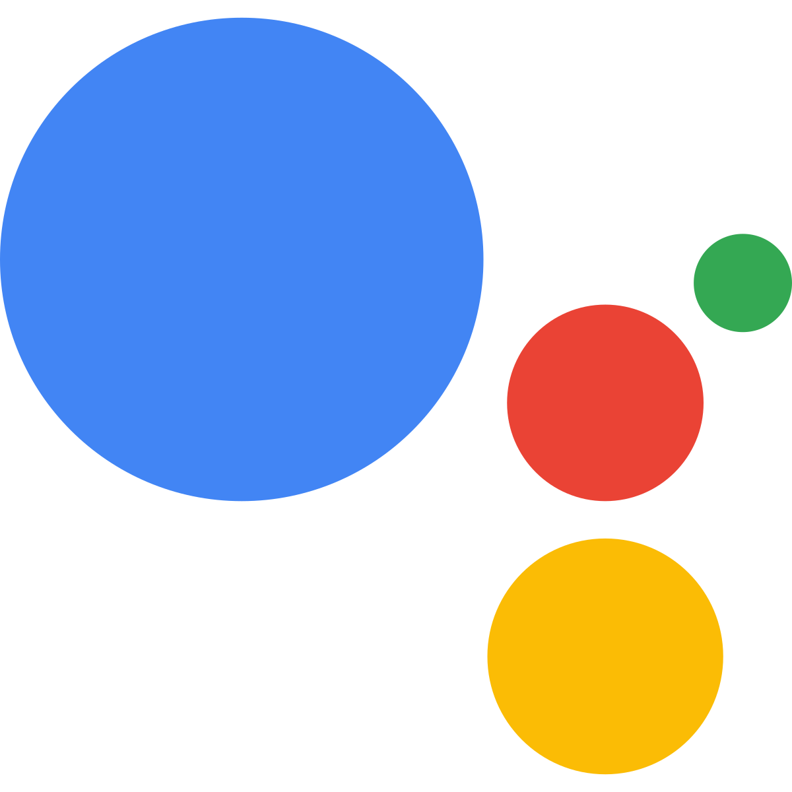

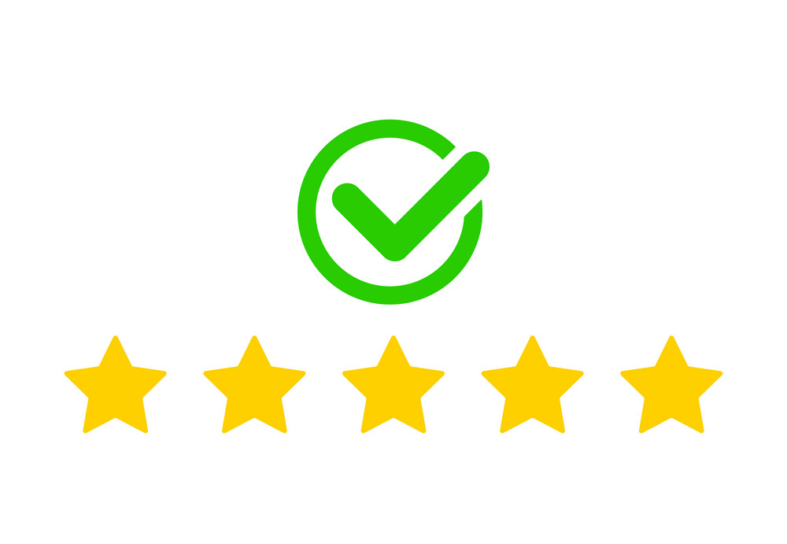

Pain Points
Want to borrow instead of buying?
Want to check the ratings of a recommended book?
Want to find the next book to read?
Have a book that you want to read but do not want to spend money to buy the book? What not borrow it?
Heard about a good book? Want to find out more about the book and the ratings?
Completed a book that you enjoy? Want to find similar books to read?

Slide 3
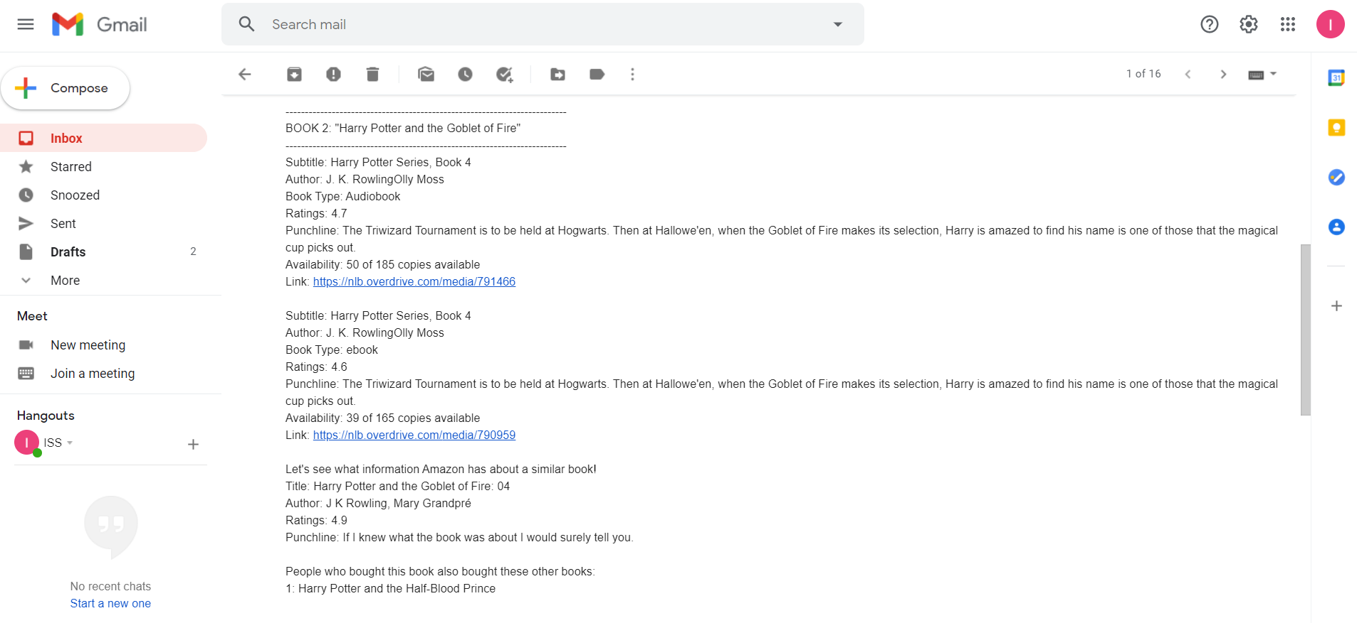
Value Proposition
Hello! I am your friendly neighbourhood Librarian. What book would you like to borrow from NLB?
I would like to borrow Harry Potter and the Goblet of Fire.
-------------------------------------------------------------------------
BOOK 1: "Harry Potter and the Goblet of Fire"
-------------------------------------------------------------------------
Subtitle: Harry Potter Series, Book 4
Author: J. K. RowlingOlly Moss
Book Type: ebook
Ratings: 4.6
Punchline: The Triwizard Tournament is to be held at Hogwarts. Then at Hallowe'en, when the Goblet of Fire makes its selection, Harry is amazed to find his name is one of those that the magical cup picks out.
Availability: 39 of 165 copies available
Link: https://nlb.overdrive.com/media/790959
Let's see what information Amazon has about a similar book!
Title: Harry Potter and the Goblet of Fire: 04
Author: J K Rowling, Mary Grandpré
Ratings: 4.9
Punchline: If I knew what the book was about I would surely tell you.
People who bought this book also bought these other books:
1: Harry Potter and the Half-Blood Prince
Would you like to enquire about another book? Current book list: Harry Potter and the Goblet of Fire
No
Ok! I will send you an email on the ratings and availability of the books that you have enquired. Thank you and Goodbye!
The availability, ratings, punchline and recommendations of selected books will be shared via email.

Slide 4
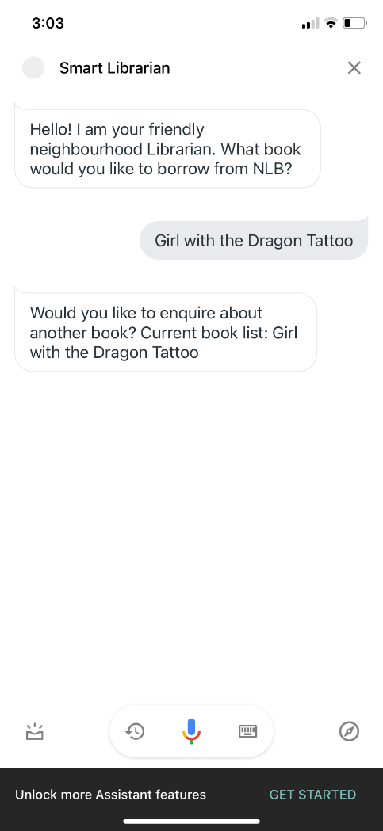
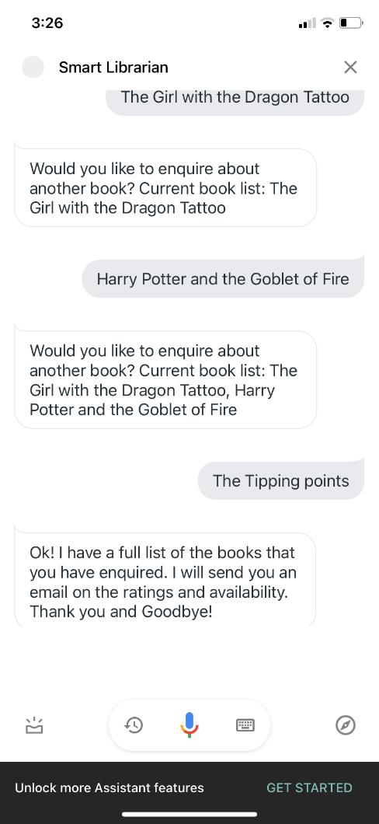
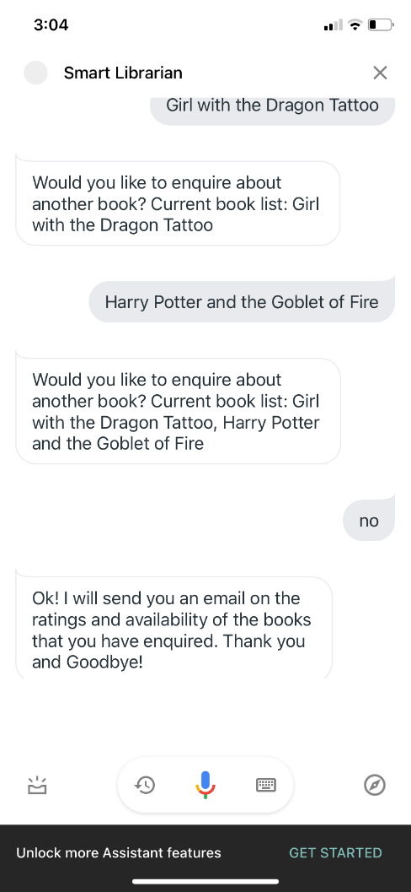
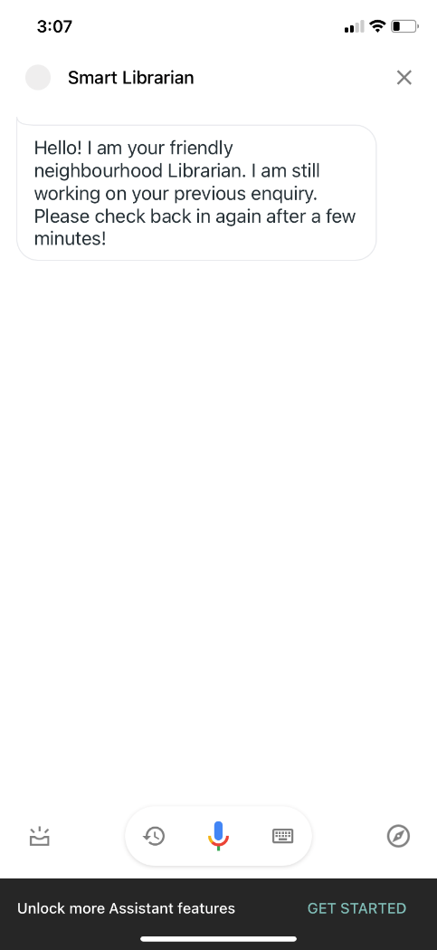
Use Case Demo – Google Assistant
SmartLibrarian starts off with a simple introduction and asks user for a book title to search for
One way to start RPA for data acquisition is when 3 books have been requested by the user
Second way to is when user decides not to add on anymore book titles
If another request is triggered while the first enquiry is ongoing data acquisition, SmartLibrarian will not function

Slide 5
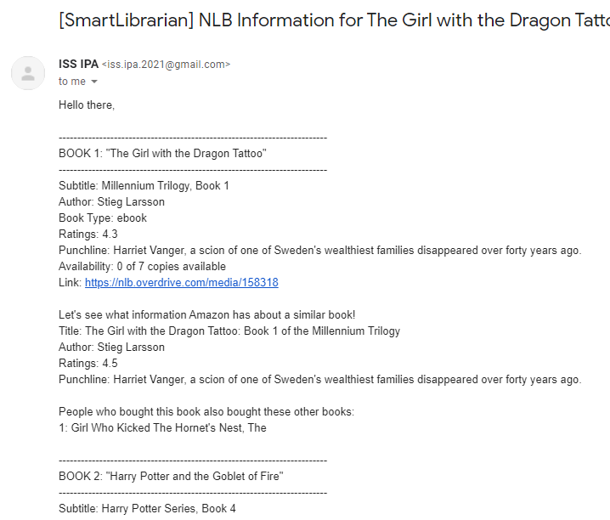
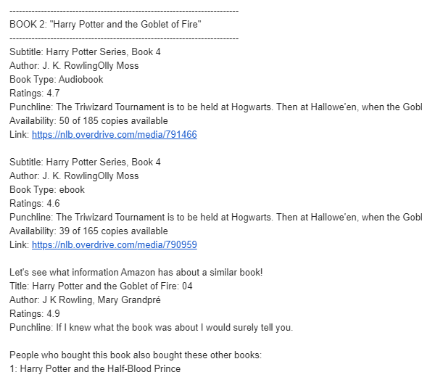
Use Case Demo – Email Information
Multiple Book Types I NLB to borrow
NLB Information
Availability
Rating
Punchline
Copies Available
Borrowing Link
Amazon Information
Rating
Punchline
Recommendations

Slide 6
Revenue Model
Support from NLB/ Government
As our application supports the goal of “highlighting the resources of NLB and promote a love of reading for pleasure and development”, it is highly likely that a collaboration can be achieved between us and NLB. This can in terms of grants or official integration of our application with the NLB website.
Advertisement/ Sponsored Recommendation System
Currently our Intelligent Book Borrowing System relies on the Amazon recommendation system for our recommendations. However, with the development of the application, our proprietary system for recommendations can be developed and integrated with sponsored recommendations. Advertisements can also be used to generate revenue for the application.

